Slide 1
Exploring Socio-Ecological systems and Ecosystem Services
Idaho EPSCoR Boise Adventure Learning Workshop 2017

Slide 2
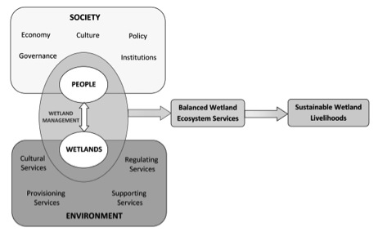
Socio-Ecological Systems: (SES) are "nested, multilevel systems that provide essential services to society such as supply of food, fiber, energy, and drinking water (Binder, 2013)."
Ecosystem Services: benefits that flow from ecosystems to humans.
[United Nations Millennium Ecosystem Assessment, 2013]
Notes:
Wetland example: Both are interacting and influencing each other

Slide 3
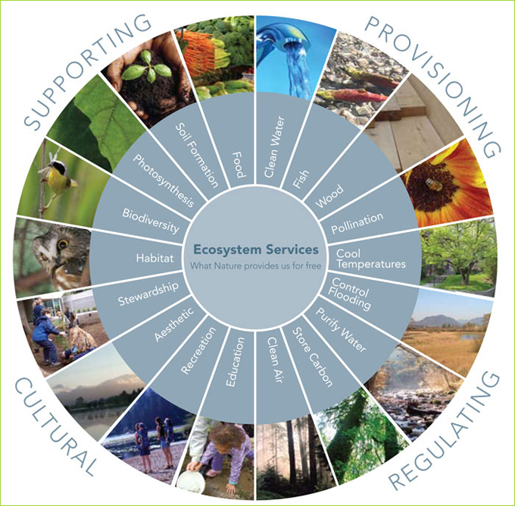
Support for other systems
Commodities
Environmental controls
Amenities
Notes:
While I respect the right of the environment to exist we can frame a sustainable environment in this way, Ecosystem services: Can be broken into 4 broad categories: For example: I value the service of pollination because it provides me with flowers in the springtime.

Slide 4
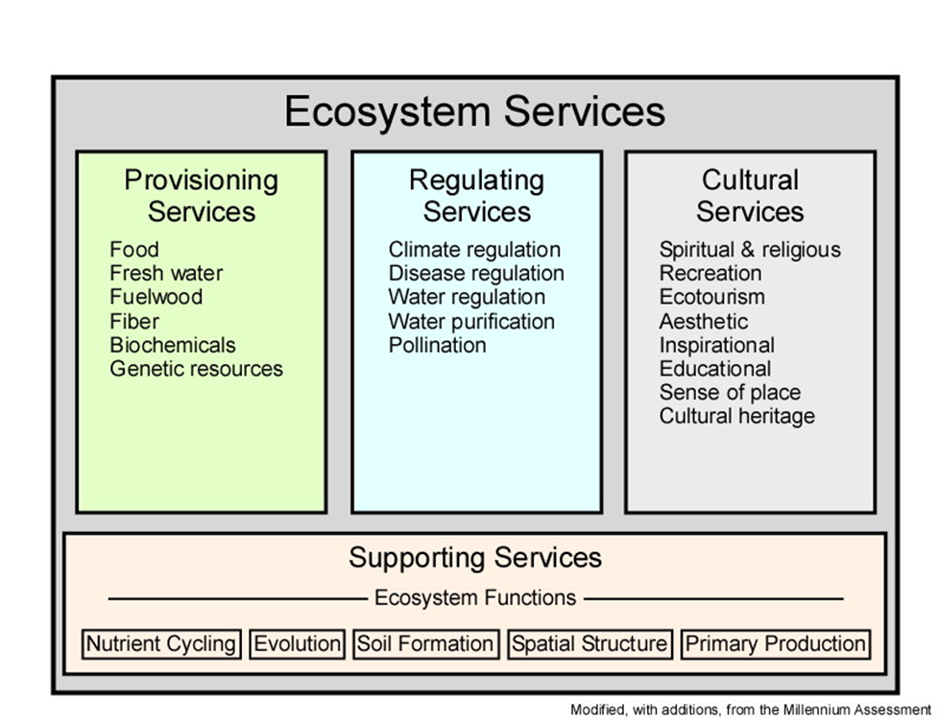

Slide 5
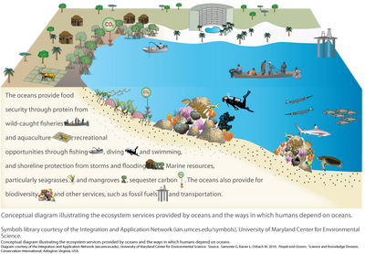

Slide 6

Some ecosystem services can be assigned economic values to help inform decision makers.

Slide 7
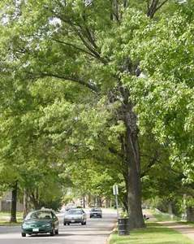
Treasure Valley Urban Tree Study
https://issuu.com/thekeystoneconcept/docs/2013_treasure_valley_utc_project_re
Found that urban tree canopy provides ecosystem services that make community cleaner and healthier. Resource should be managed.
For example, aesthetics, store carbon, clean water, clean air, and cool temperatures
Notes:
For example, aesthetic, store carbon, cool te

Slide 8
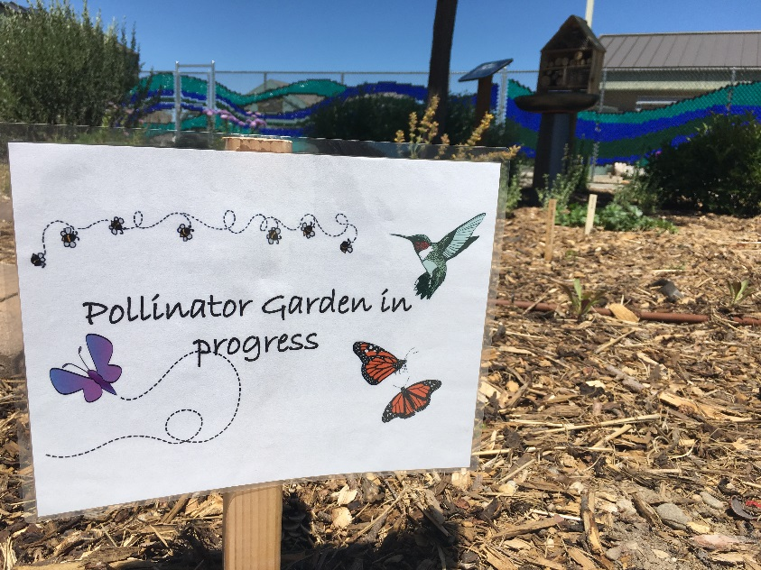
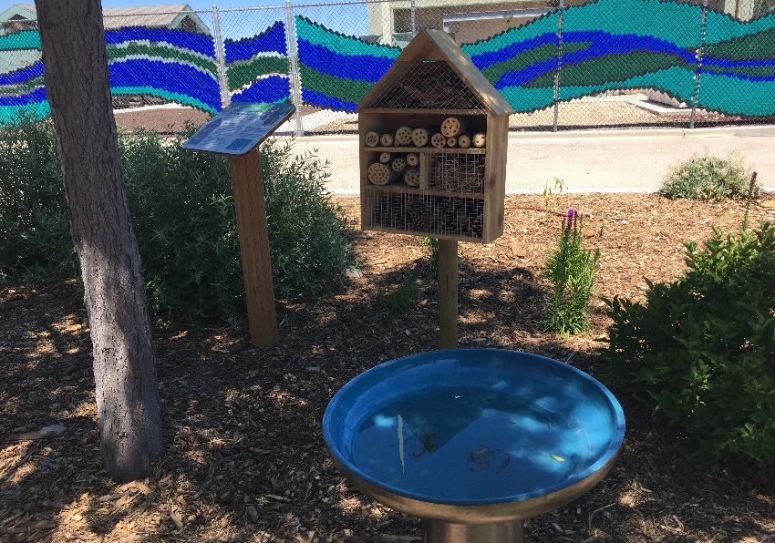
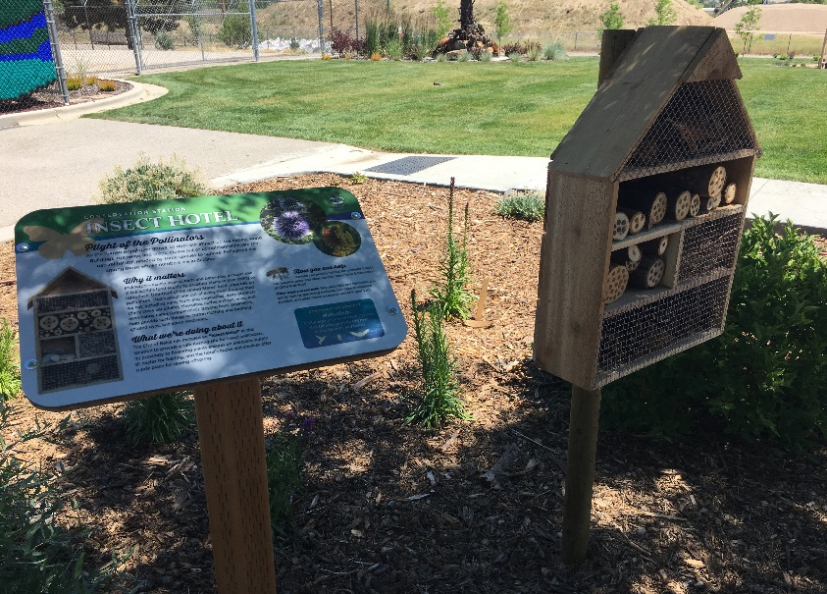
Boise WaterShed Learning Center
Pollinator garden:
Pollinators provide food we eat, fibers for clothes, and reproduction of native plants.
One out of three bites of food is thanks to pollinators.
Managed honey bees benefit $14.6 billion to US consumers

Slide 9
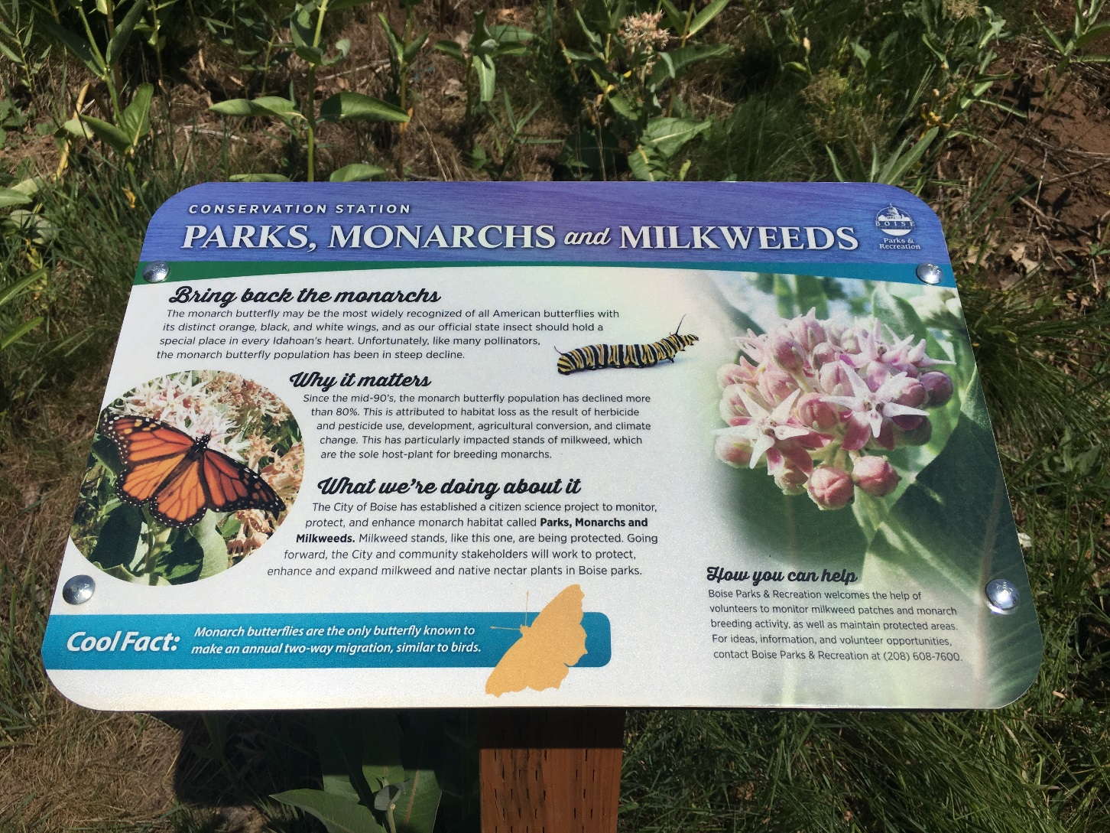
Monarchs and Milkweed
Notes:
An example of biodiversity loss, which is a valuable ecosystem service because they support other ecological systems and are pollinators which provide commodities to humans

